Slide 1
Symbolic Self-Completion as Mediator between Nicotine Dependence and Quit Intention
Funded by FSFW (P-0064)
PROF. DR. BERNA TARI KASNAKOĞLU
PROF. DR. ASENA CANER

Slide 2
THE LITERATURE
Dichotomous approach to cessation → stages model (DiClemente et al., 1991; Owen et al., 1992)
Smoking is a self-related activity
Not only physical but also psychological, social, and cultural dependence (Wicklund and Gollwitzer, 2013)
Symbolic self-completion is defined as an individual’s implementation of symbols or execution of identity-related tasks to retain the completeness of one’s self-definition (Mead, 1934)

Slide 3
THE HYPOTHESES
Highly dependent smokers may have greater difficulty with initial cessation (Warner and Burns, 2003)
H1: Higher dependence is associated with a lower level of quit intention
The “strength of smoker identity”, usually measured by asking how important smoking is to the individual (Falomir-Pichastor et al., 2020)
Smoking not only in terms of its centrality but also in terms of its valence
The smoker self is thus constructed per other life choices and within a socio-cultural context

Slide 4
THE HYPOTHESES
An individual would find it easier to quit smoking if the self is not symbolically (positively) attached to smoking
H2: Absence of symbolic self-completion leads to a greater intention to quit smoking
H3: Smoker’s symbolic self-completion mediates the relationship between dependence and quit intention
Addiction would not only deepen the roots of smoking in identity, but also increase the symbolic attachments through time
H4: Higher dependence increases symbolic self-completion

Slide 5
METHODS
Survey methodology with a nationally representative sample
Valid N | 1020 smokers
Gender | Female 33%
Mean age | 35,06 years old
Education level | Primary or secondary education 33% High school 36% University or higher 31%
Monthly household income | $263 or less 22% $263-360 14% $360-513 14% $513-730 20% $730-1570 20% More than $1570 8%

Slide 6
MEASURES
Nicotine Dependence: Heaviness of Smoking Index (HSI)
Composite measure of cigarettes consumed per day + the time to the first cigarette after waking up
Quit Intention: 3 questions
“I want to quit smoking”
“I want to reduce if not quit smoking”
“I am not sure if I want to quit in the near future” - “I will quit within the next year” - “I will quit within the next month”
Absence of Symbolic Self-Completion (ASC)
“Smoking does not suit me”
“Ideally, I would not be a smoker”
“My perfect self does not smoke”
“My family and/or friends do not approve of my smoking.”

Slide 7
MEASURES
After confirmatory factor analysis | HSI | QI | ASC
Number of items | 2 | 3 | 4
Cronbach’s alpha | 0.606 | 0.740 | 0.622
Mean value | 2.4971 | 1.7034 | 1.5028
Correlation coefficients
HSI | 1 | -0.104** | -0.105**
QI | - | 1 | 0.518**
ASC | - | - | 1
**Correlation significant at 0.05.

Slide 8
RESULTS
Significant main effect
HSI → QI with coefficient=-0,039**
H1
H2
H3
H4
✓
Outcome Variable: QI
Model (R=0,5197; R²=0,2701; MSE=0,3619; F=185,4002; df1=2; df2=1002; p=0,0000)
 | Coefficient | se | t | p-value | LLCI | ULCI
Constant | 0,8254 | 0,0603 | 13,6968 | 0,0000 | 0,7071 | 0,9436
HSI | -0,0198 | 0,0101 | -1,9603 | 0,0502 | -0,0397 | 0,0000
ASC | 0,6118 | 0,0325 | 18,8464 | 0,0000 | 0,5481 | 0,6755
Outcome Variable: ASC
Model (R=0,1045; R²=0,0109; MSE=0,3424; F=11,0759; df1=1; df2=1003; p=0,0009)
 | Coefficient | se | t | p-value | LLCI | ULCI
Constant | 1,5831 | 0,0306 | 51,7190 | 0,0000 | 1,5230 | 1,6432
HSI | -0,0326 | 0,0098 | -3,3281 | 0,0009 | -0,0518 | -0,0134
✓
✓
partial
✓

Slide 9
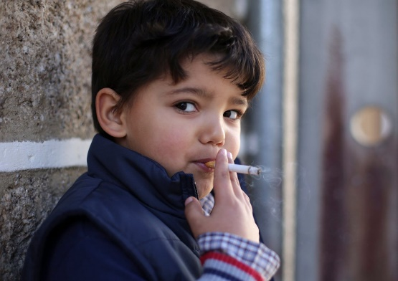
CONCLUSION
The intention to quit or continue smoking is not solely a function of motivation (LeGrande et al., 2021)
And not only based on an objective evaluation of physical dependence (Brandon and Baker, 1991)
Meanings are constructed at a symbolic level (Gollwitzer, 1986)
Symbolic value is not determined on a personal basis, but rather evaluated on a socio-cultural basis within a circle of interacting individuals (Ioannou and Pike, 2010)
Trial of new selves is risky

Slide 10
THANK YOU FOR LISTENING
Funded by FSFW (P-0064)
PROF. DR. BERNA TARI KASNAKOĞLU
btari@etu.edu.tr
PROF. DR. ASENA CANER
acaner@etu.edu.tr

